Slide 1
Automated Blood Cell Identification and Counting
Sridevi Sowmya Grandhi - 50309828
May 2nd 2024

Slide 2
Section Title Here
Section Info Here

Slide 3
Outline
Introduction

Slide 4
Introduction
Why this research is important | This research addresses the challenges in analysing blood cell in traditional methods, while offering a potential breakthrough in accuracy, efficiency, and reliability of disease diagnosis. The automation using advanced image processing and machine learning could revolutionize medical diagnostics, leading to improved patient outcomes.
What we know and what we don’t know | The limitations of manual blood cell analysis, emphasizing the need for automation. Leverages existing methodologies and acknowledges advancements in models like YOLOv5 and YOLOX. The specific limitations of current approaches are unaware and how the proposed solution will overcome them in areas that the project aims to explore.

Slide 5
Introduction (Cont’d)
Our Experiment | This experiment develops an automated system for blood cell analysis using image processing and machine learning. The process includes image preprocessing, feature extraction, and the implementation of machine learning models for the classification and counting of blood cells.
Our Hypothesis | By combining solutions in image processing and machine learning, the developed system will significantly improve the accuracy and reliability of blood cell identification and counting. It is expected to streamline the analysis process, reduce time and labor requirements, and enhance the diagnostic capabilities of healthcare professionals

Slide 6
Methodology
You Only Look Once (YOLO) - Real-Time Object Detection
YOLO Versions V1-V8
YOLO-NAS is a next-generation object detection model that has been developed using the Neural Architecture Search (NAS) technology.
NAS is an automated process that searches for the optimal neural network architecture for a particular task.
It does this by exploring a vast search space of possible architectures and selecting the most efficient and high-performing one.
The new YOLO-NAS delivers state-of-the-art (SOTA) performance with the unparalleled accuracy-speed performance

Slide 7
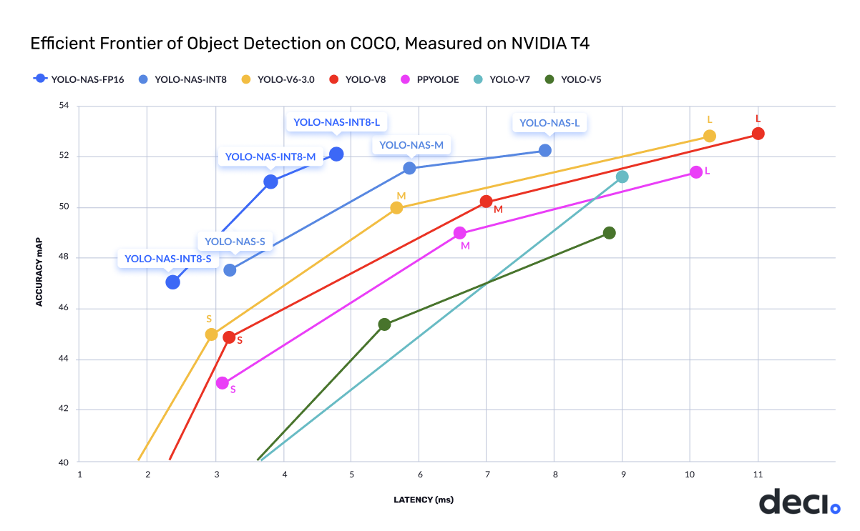
Methodology – Yolo-NAS
COCO – Common Object in Context
Object segmentation
330K images (>200K labelled)
1.5 million object instances
80 object categories

Slide 8
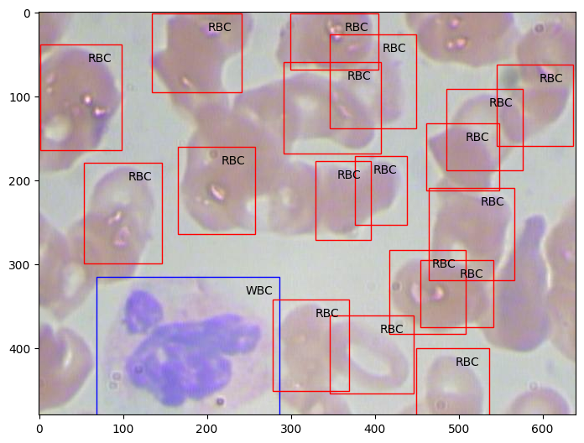
Sample Image
Collection of sample images to train.
Mark the rectangles as X, Y or width and Height from Annotations Data set.
Identify RBC, WBC and Platelets.
Color them in RGB Channels.

Slide 9
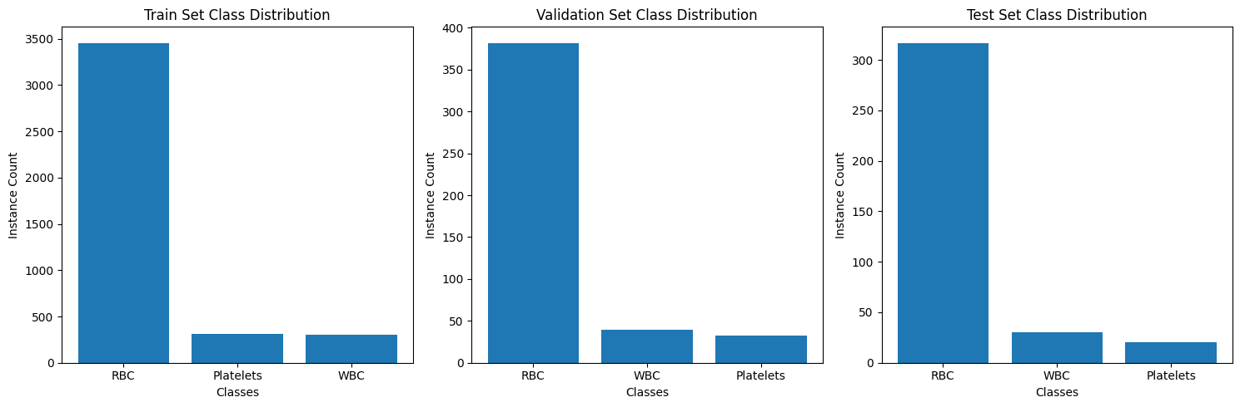
Training and Validations Data set
Datasets are evenly distributed as Train, Validation and Test Sets
Train – Model to be trained
Validation – Trained model is validated
Test – Trained models are been tested.

Slide 10
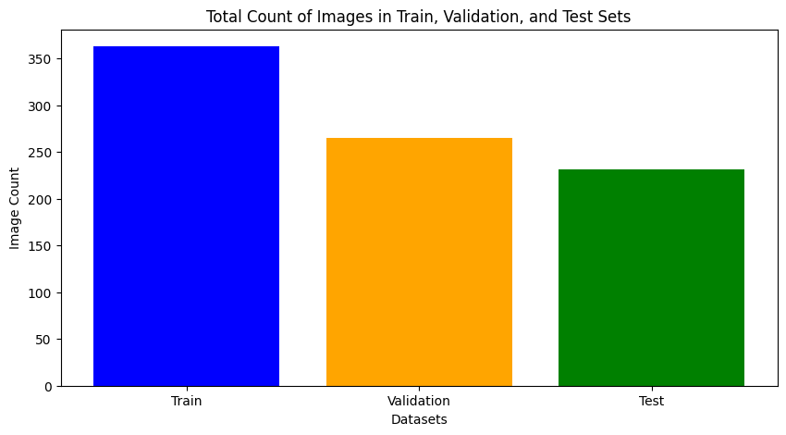
Training and Validations Data set
No. of Training images 363
No. of Training labels 363
No. of valid images 269
No. of valid labels 269
No. of test images 213
No. of test labels 213

Slide 11
Training and Validations Data set
No. of Training images 363
No. of Training labels 363
No. of valid images 269
No. of valid labels 269
No. of test images 213
No. of test labels 213

Slide 12
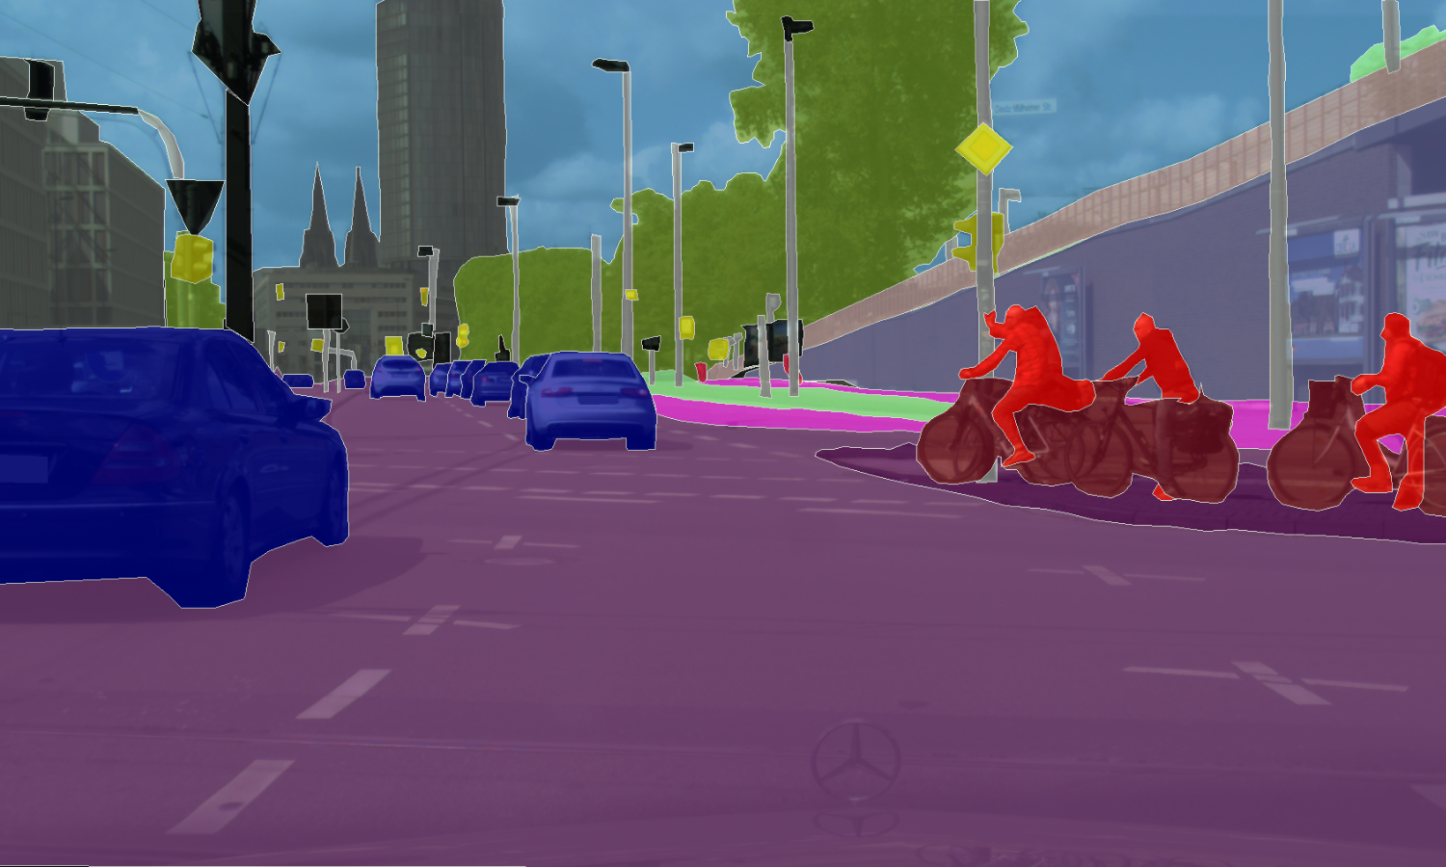
Fine Tuning
Super Gradient is a Library used to identifying and training models with high accuracy and performance
Easy to train the model in RGB Channels.
The blue is trained as cars, Red as persons, Green as trees etc.

Slide 13
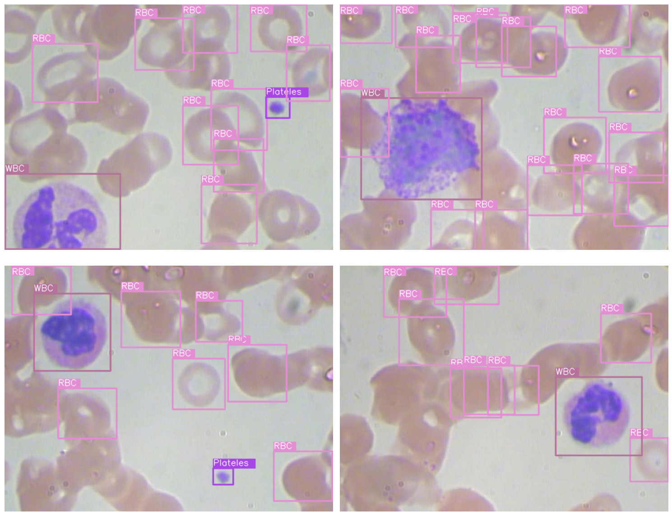
Fine Tuning
Trained the model by passing 16 images at a time
Machine with 8GB GPU
The models are able to identify RBC, WBC and Platelets

Slide 14
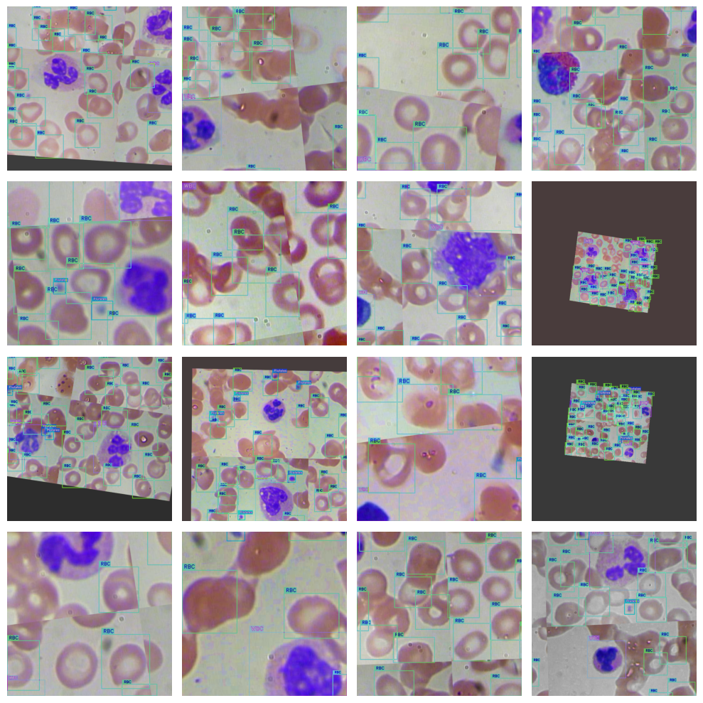
Fine Tuning
Transformed images
Flipped Images
Different filters of colors

Slide 15
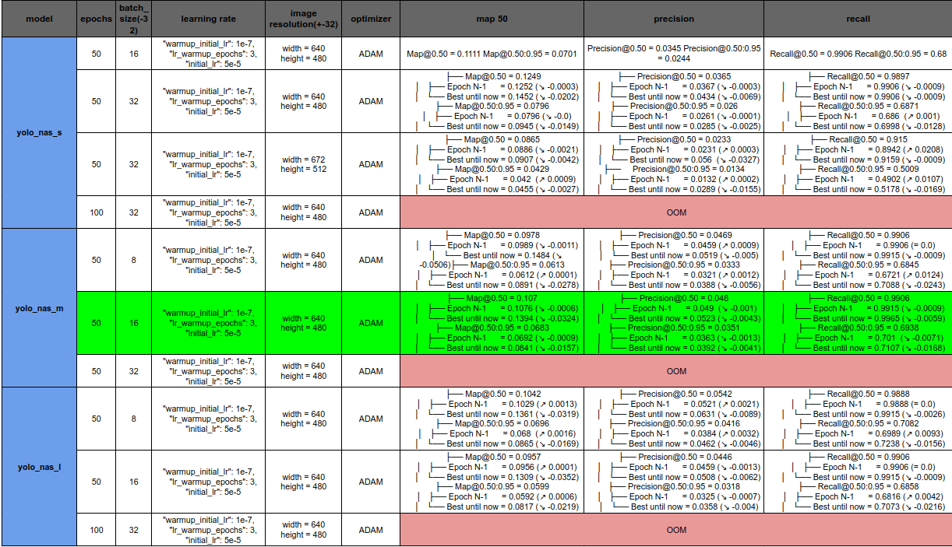
Result
The trained model has been downloaded.
The model is tested using 3 Configurations YOLO_NAS_S – Small YOLO_NAS_M – Medium YOLO_NAS_L – Large
The sizes of model determines its accuracy andefficiency
Our model gave us high accuracy using YOLO_NAS_M

Slide 16
Thank You
Sridevi Sowmya Grandhi - 50309828
May 2nd 2024

